Slide 1
Online Movie Ticket Booking System
Object Oriented Programming Project

Slide 2
Team MEMBERS (GROUP-03)
Roll Number | Team Member Name
VAS25CS001 | Aaron Thalakkottor Sooraj
VAS25CS012 | Abinandh P. S.
VAS25CS017 | Adhin Seby
VAS25CS026 | Adwaith S. Kumar
Department of Computer Science & Engineering
Semester 3, A Class
GitHub Repository: ATS-001/OnlineMovieBooking

Slide 3
introduction
Online Movie Ticket Booking System is a robust Java-based application developed using Object-Oriented Programming concepts. The system enables users to browse available movies, select show timings, choose seats, make bookings, and manage reservations efficiently.
The application uses Java+Swing for the frontend logic and MySQL as the backend database, connected using JDBC using the DAO (Data Access Object) design pattern.

Slide 4
Problem Statement & Limitations
Traditional ticket booking methods often involve:
Long Queues & Delays: Traditional manual counter bookings are time-consuming and inconvenient.
Manual Record-Keeping: Relies on paper or legacy files, leading to high administrative overhead.
Double-Booking Risks: Lack of real-time tracking causes duplicate seat allocations and human errors.
System Solution: An automated, database-driven desktop application ensuring real-time seat availability, atomic transactions, and instant conflict detection.
Our system provides an automated solution that improves efficiency and enhances user experience.

Slide 5
Project Objectives
Application Development: Build a functional, desktop-based online movie ticket reservation system using Java (Swing/AWT).
OOP Implementation: Apply core Object-Oriented Programming principles (Encapsulation, Inheritance, Polymorphism, Abstraction).
Database Persistence: Establish robust database connectivity using JDBC to store user, movie, show, and booking data securely in MySQL.
Concurrency & Integrity: Implement atomic transactions and conflict detection mechanisms to prevent duplicate seat bookings.
User Experience: Provide intuitive interfaces for customers (catalog browsing, interactive seating, UPI/Card checkout) and administrators (catalog and show scheduling)

Slide 6
Background study
Industry Landscape: Modern entertainment platforms provide seamless online ticket reservation, real-time seat selection, and digital payment facilities.
Project Scope: Our system recreates these essential booking functionalities within a lightweight desktop application framework.
Academic Objective: Demonstrates the practical application of Object-Oriented Programming (OOP) design principles, relational database integration, and software engineering standards.

Slide 7
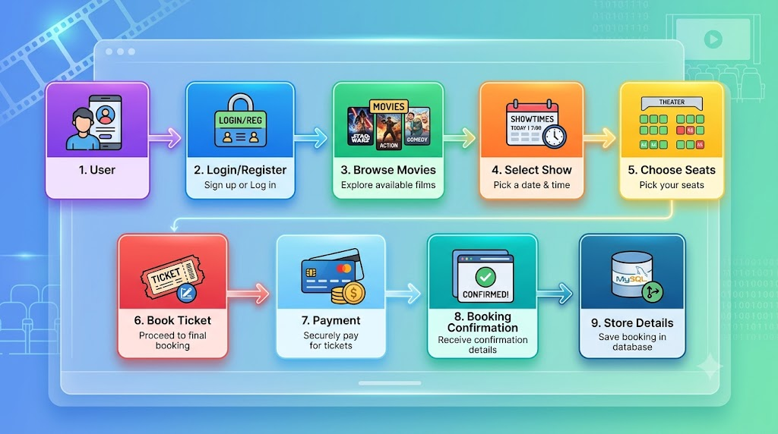
methodology

Slide 8
System Architecture & Design Pattern
The application is structured following a modular desktop architecture implementing the Data Access Object (DAO) design pattern to cleanly decouple the user interface from database operations.
Presentation Layer | Java Swing GUI (Frames & Panels)
Business Logic Layer | Domain Models & Controllers
Data Access Layer | DAO Classes (UserDAO, MovieDAO, BookingDAO, PaymentDAO)
Persistence Layer | MySQL Relational Database via JDBC
Frontend GUI | Java Swing & AWT (LoginFrame, RegisterFrame, MovieFrame, ShowFrame, SeatSelectionFrame, AdminDashboard)
Backend Persistence | MySQL Server connected via JDBC driver (mysql-connector-j)
Concurrency Control | Pessimistic locking (SELECT ... FOR UPDATE) and JDBC atomic transactions to prevent double-booking conflicts

Slide 9
Project’s Team Members Responsibilities
Roll Number | Team Member Name | Assigned Domain & Responsibilities
VAS25CS001 | Aaron Thalakkottor Sooraj | Database Architecture, JDBC Connectivity, & System Integration
VAS25CS012 | Abinandh P. S. | Movie & Show Management, Catalogs, and Admin Scheduling
VAS25CS017 | Adhin Seby | Seat Selection UI, Booking Logic, & Polymorphic Payment Modules
VAS25CS026 | Adwaith S. Kumar | User Authentication, Registration, and Role/Profile Handling

Slide 10
OOP CONCEPTS USED
CLASS
Movie
User
Booking
Seat
Show
Admin
OBJECTS
Each Movie, Customer, Show , Booking
INTERFACE
Payment [UPIPayment| CardPayment]
POLYMORPHISM
Method Overriding & Overloading
INHERITANCE
Admin and Customer inherit from User.
ENCAPSULATION
Access is provided using getter and setter methods
ABSTRACTION
Abstract classes for booking operations.

Slide 11
modules
USER & AUTH
User Registration
Secure Login & Session
Profile Management
SHOW SCHEDULING
Add Shows
Update Timings
View Shows
Hall Mapping & Timings
Custom Ticket Pricing
PAYMENT PROCESSING
Polymorphic Checkout Interface
UPI VPA Validation
Credit/Debit Card Masking
MOVIE CATALOG
Add Movies
Search & Filter Catalogs
View Movies
Update Movies
Delete Movies
ADMIN CONTROL
Admin Dashboard
Manage Movies, Shows, & Users
Centralized Booking Ledger
SEAT BOOKING
Interactive Seat Grid (Rows A–J)
Real-Time Seat Availability
Conflict Prevention (Pessimistic Locking)
Ticket Confirmation

Slide 12
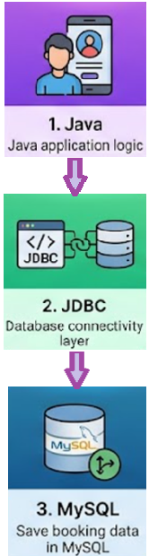
Backend Design
MySQL Tables
Movies
Shows
Seats
Bookings
Payments
Users

Slide 13
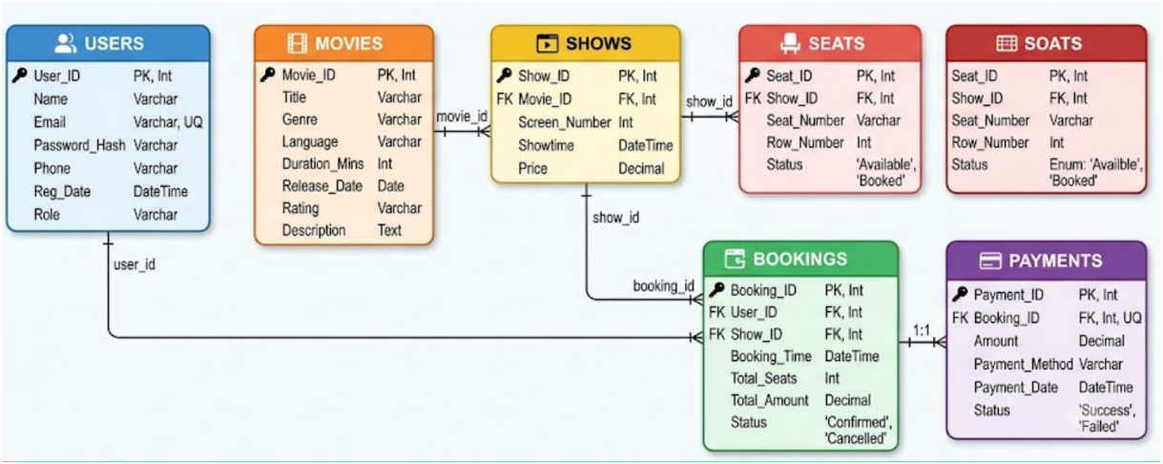
Database ER Diagram
Database ER Diagram

Slide 14
Class Diagram
USER
CUSTOMER
BOOKING
ADMIN
MOVIE
MOVIE
SEAT
SHOW
payment
payment
PAYMENT

Slide 15
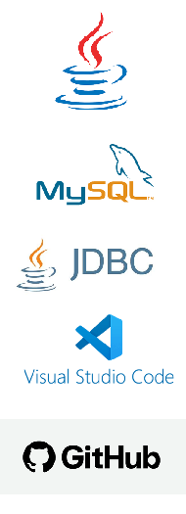
TOOLS AND TECHNOLOGIES
Programming Language: Core Java
GUI Framework: Java Swing & AWT
DBMS: MySQL Server
Database Connectivity: JDBC via MySQL Connector
Development Environment: VSCode
Version Control: GitHub

Slide 16
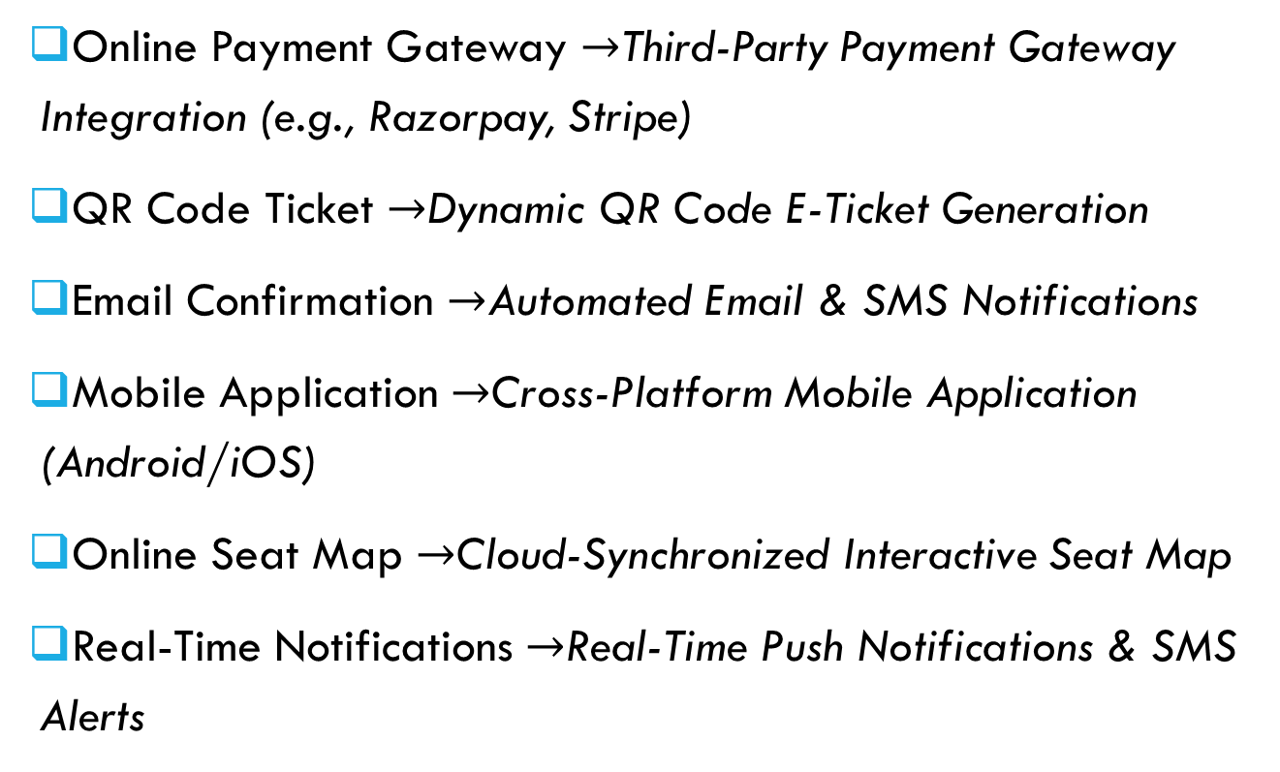
Future Enhancements
Online Payment Gateway $→$Third-Party Payment Gateway Integration (e.g., Razorpay, Stripe)
QR Code Ticket $→$Dynamic QR Code E-Ticket Generation
Email Confirmation $→$Automated Email & SMS Notifications
Mobile Application $→$Cross-Platform Mobile Application (Android/iOS)
Online Seat Map $→$Cloud-Synchronized Interactive Seat Map
Real-Time Notifications $→$Real-Time Push Notifications & SMS Alerts

Slide 17
Conclusion
Core Objective Achieved: Successfully developed an Online Movie Ticket Booking System demonstrating practical Object-Oriented Programming (OOP) concepts using Java.
System Impact: Automates movie ticket reservations, minimizes manual record errors, and provides scalable persistence using a relational MySQL database backend.
Technical Takeaways: Strengthened team proficiency in Java Swing GUI development, JDBC transaction handling, normalized database design, and modular software engineering.

Slide 18
Thank you

